Slide 1


NEXT GEN EMPLOYABILITY PROGRAM
CREATING A FUTURE-READY WORKFORCE
Student Name :
Kritika Tripathi
Student ID :
College Name :
STU63e319dca43c21675827676
Vellore Institute of technology, Bhopal

Slide 2
CAPSTONE PROJECT SHOWCASE
Customer- Segmentation using K-means clustering
Abstract | Problem Statement | Project Overview | Proposed Solution | Technology Used | Modelling & Results | Conclusion | Q&A

Slide 3
Abstract
1
Analyze a transactional dataset from a UK-based online retailer (2010-2011)
2
Enhance marketing strategies and sales through customer segmentation
3
Utilize K-means clustering for customer segmentation
4
Develop a recommendation system for personalized product suggestions

Slide 4


Problem Statement
Analyze transactional dataset from a UK-based online retailer
Objective: Improve marketing strategies and boost sales through customer segmentation
Use K-means clustering to segment customers based on transactional data
Understand distinct profiles and preferences of different customer groups
Develop recommendation system to suggest top-selling products to customers
Enhance marketing effectiveness and increase sales

Slide 5

Project Overview
Objective: Analyze transactional dataset from a UK-based retailer (2010-2011) for efficient marketing and sales boost.
Approach: Customer segmentation using K-means clustering for personalized marketing strategies
Dataset: Available at UCI Machine Learning Repository, documenting all transactions.

Slide 6
Proposed Solution
Data Cleaning & Transformation: Handle missing values, duplicates, and outliers to prepare the dataset.
Feature Engineering: Create new features from transactional data to make it customer-centric.
Data Preprocessing: Scale features and reduce dimensionality for efficient clustering.
Customer Segmentation using K-Means Clustering: Segment customers into groups based on behavior.
Cluster Analysis & Evaluation: Analyze clusters to understand customer profiles and preferences.
Recommendation System: Suggest products to customers based on their segment to boost sales.

Slide 7
Technology used
Programming Language: Python
Libraries: Pandas, NumPy, Scikit-learn
Visualization: Matplotlib, Seaborn
IDE: Jupyter Notebook or any Python IDE
Data Storage: CSV or Excel files
Machine Learning: K-means Clustering

Slide 8
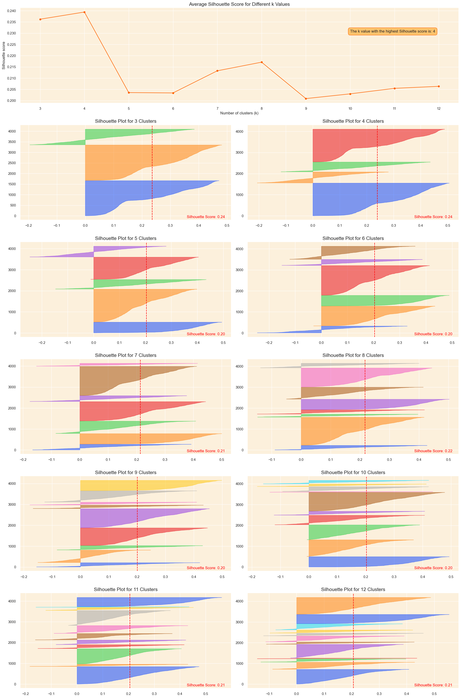
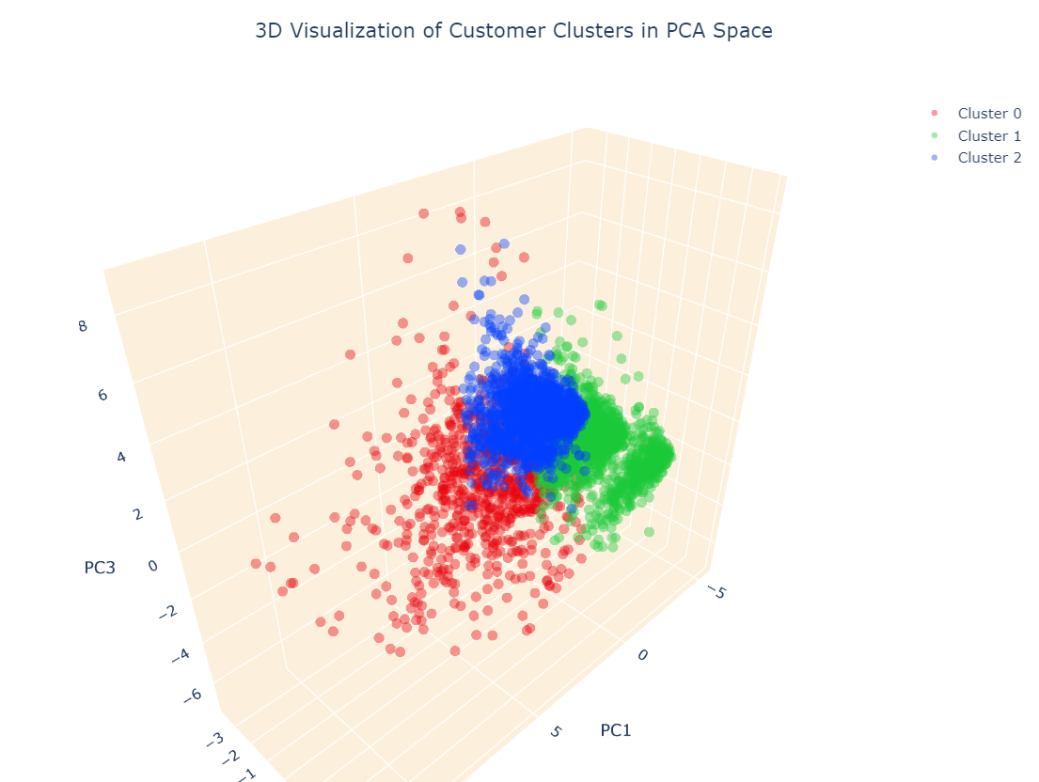
Modelling & Result

Slide 9
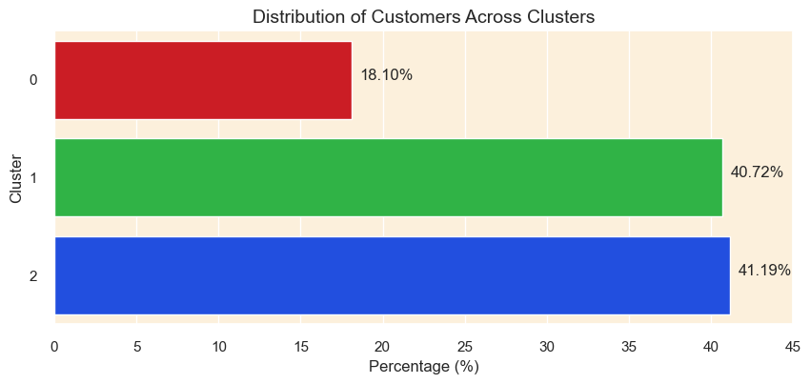
Modelling & Result

Slide 10
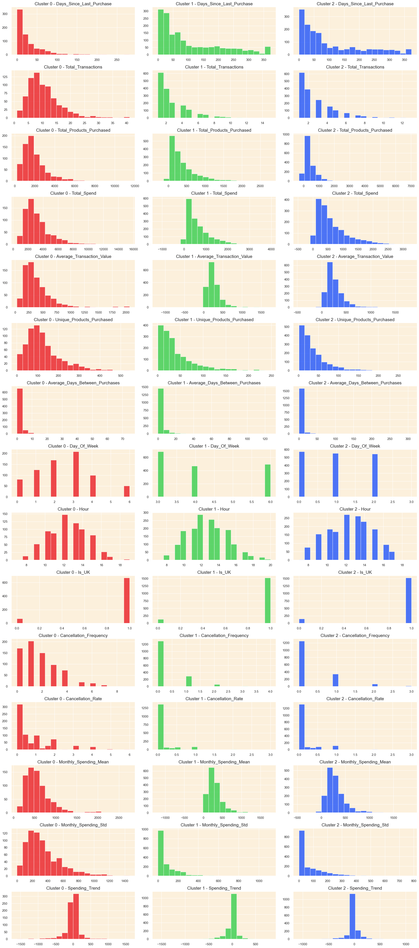
Modelling & Result

Slide 11

Conclusion
Explored an online retail dataset to enhance marketing and sales through customer segmentation and a recommendation system. Cleaned and transformed data, engineered features, and used K-means clustering for segmentation. Developed targeted marketing strategies and a recommendation system for increased sales.

Slide 12


Notes:
Thank You !!

